Slide 1

Learning Robot Motion Control
from Demonstration and Human Advice
Brenna D. Argall
bargall@ri.cmu.edu
Dr. Brett Browning
Prof. Manuela Veloso
School of Computer Science
Carnegie Mellon University
AAAI Spring Symposium : 23 March 2009 <number> Brenna D. Argall : The Robotics Institute

Slide 2
Motion Control for Mobile Robots
Challenges:
- Noisy Sensors
- Non-deterministic actions
- Complex motion trajectories
- Development requirements
- lots of tuning
- lots of expertise
- Want complex behaviors
AAAI Spring Symposium : 23 March 2009 <number> Brenna D. Argall : The Robotics Institute

Slide 3
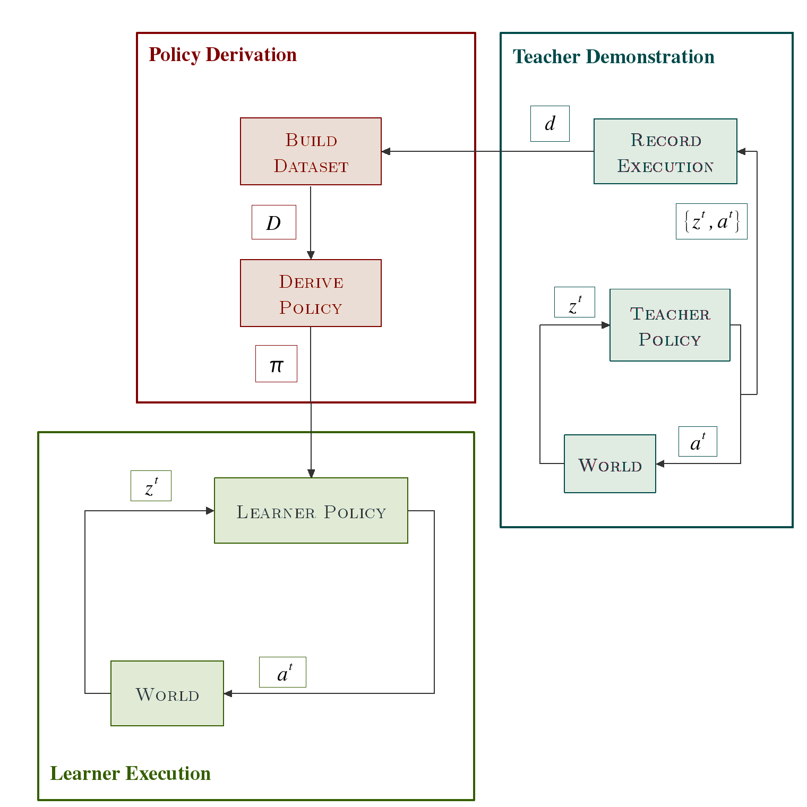
Learning from Demonstration
Benefits:
- Representation
- Demonstration
- Successful robot applications
Common Errors:
- Correspondence
- Undemonstrated state
- Suboptimal teacher
AAAI Spring Symposium : 23 March 2009 <number> Brenna D. Argall : The Robotics Institute

Slide 4
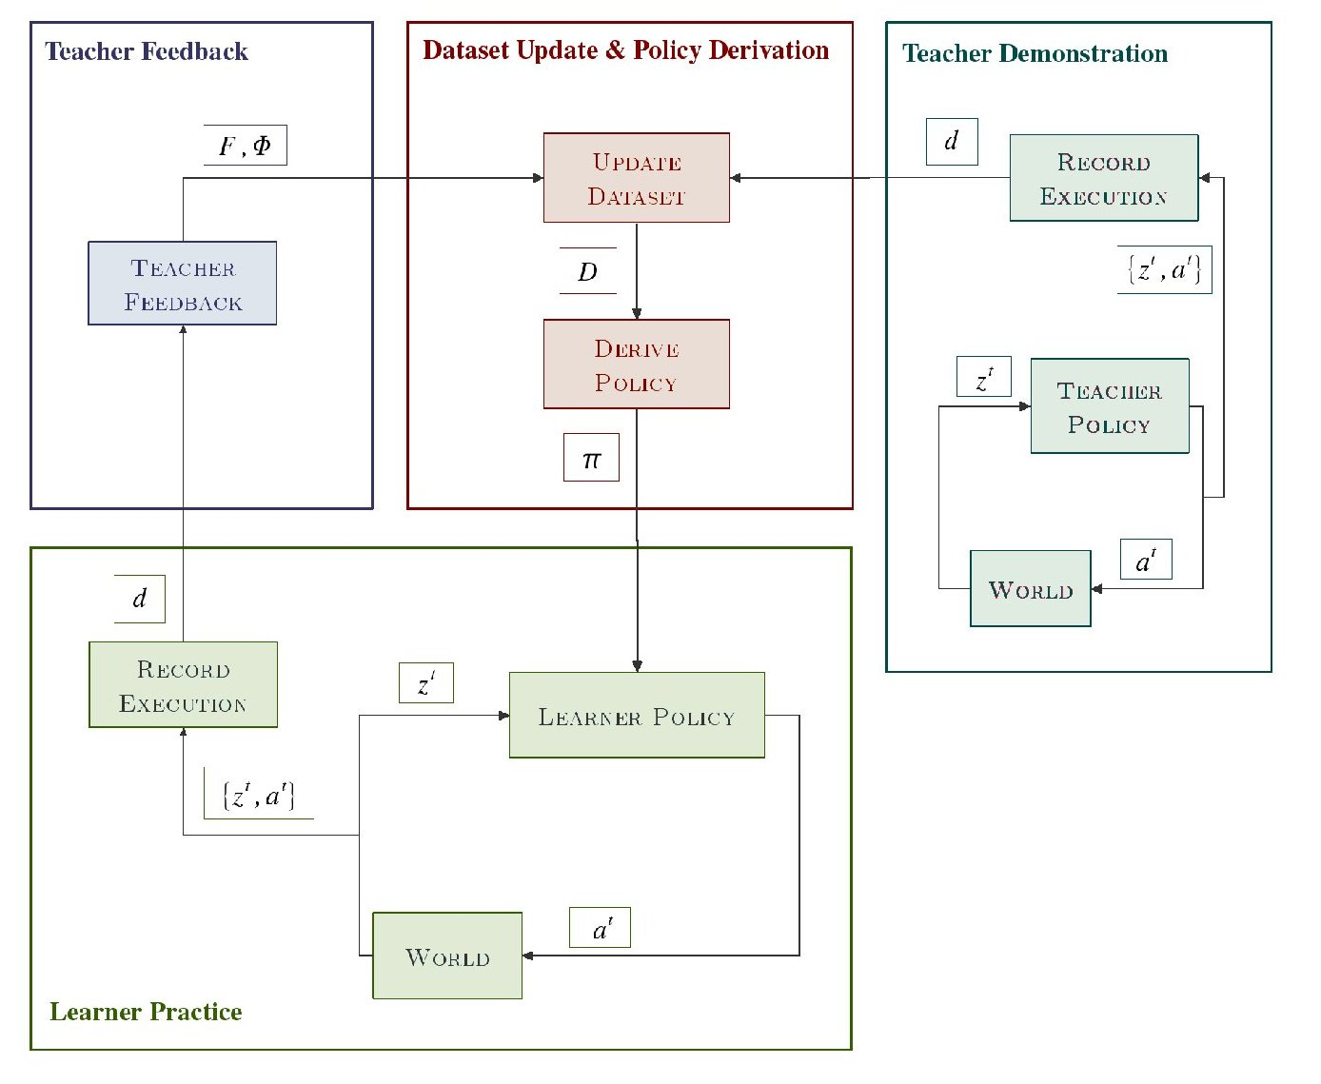
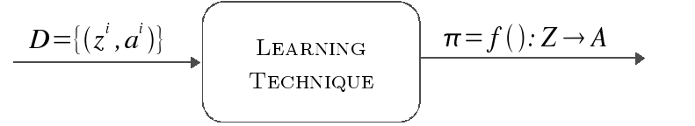
Our Approach
Multiple feedback types
Focused application of the feedback
Human teacher evaluation
Multiple feedback rounds
(practice runs)
AAAI Spring Symposium : 23 March 2009 <number> Brenna D. Argall : The Robotics Institute

Slide 5

Update from Execution Experience
More teacher demonstrations.
[Calinon & Billard] [Chernova & Veloso] [Grollman & Jenkins]
Populates undemonstrated areas; clarifies ambiguous areas.
Does not address poor correspondence or suboptimal demonstrator.
Requires revisiting state.
State reward.
Correcting an execution.
[Chernova & Veloso] [Nicolescu & Mataric]
Addresses poor correspondence and suboptimal demonstrator.
Does not require revisiting state (hopefully).
Applied only to discrete-valued, infrequently sampled, action domains.
Preview: Advice-Operators
Applied to continuous-valued, frequently sampled, action domains.
AAAI Spring Symposium : 23 March 2009 <number> Brenna D. Argall : The Robotics Institute

Slide 6
Feedback Types
Information amount?
Continuity?
Incorporation?
Granularity?
Critique
Adjust policy use of existing data
Low
Binary
Fine
Correction
Generate new data,
rederive policy
High
Continuous-valued
Fine: High frequency, strict data association.
AAAI Spring Symposium : 23 March 2009 <number> Brenna D. Argall : The Robotics Institute

Slide 7
Example LfD Policy Derivation
Demonstration Dataset:
Actions
Select action
Dataset Point
1-NN Policy
Target Behavior
Query Point
Observations
AAAI Spring Symposium : 23 March 2009 <number> Brenna D. Argall : The Robotics Institute

Slide 8
Feedback: Critique
Pro: Credit dataset points
Con: No directionality w.r.t. query
Con: No indication of preferred action
Con: Restricted to dataset actions
Actions
Dataset Point
1-NN Policy
Target Behavior
Query Point
Pre-feedback Policy
Observations
AAAI Spring Symposium : 23 March 2009 <number> Brenna D. Argall : The Robotics Institute

Slide 9
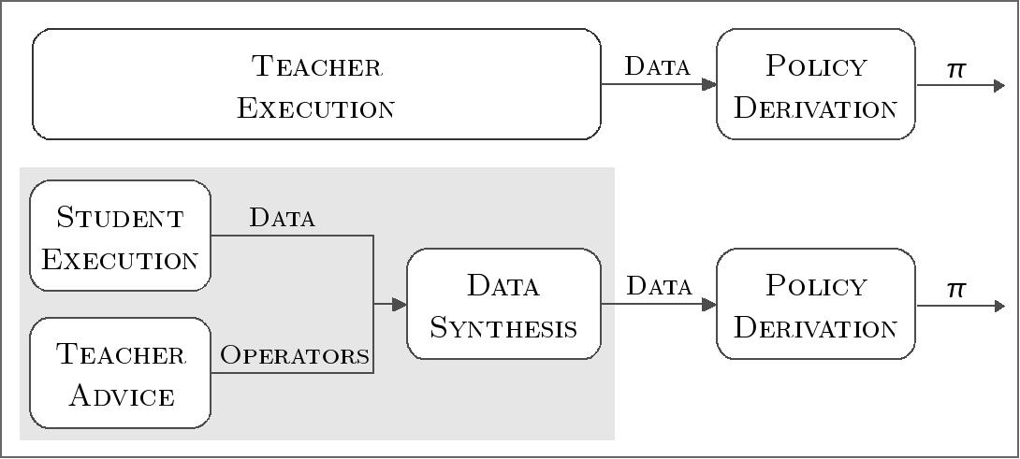
Advice-Operators
- Defined jointly between the teacher and student
- Perform mathematical computations on student executions
- Produce new synthesized data
Example: Increase translational speed
Operator
Increase speed
AAAI Spring Symposium : 23 March 2009 <number> Brenna D. Argall : The Robotics Institute

Slide 10
Feedback: Correction
Pro: Credit dataset points
Con: No directionality w.r.t. query
Con: No indication of preferred action
Con: Restricted to dataset actions
Suppose receives correction
Add
to dataset
Pro: Indication of preferred action
Pro: Not restricted to dataset actions.
Dataset Point
1-NN Policy
Target Behavior
Query Point
Pre-feedback Policy
Observations
AAAI Spring Symposium : 23 March 2009 <number> Brenna D. Argall : The Robotics Institute

Slide 11
More Complex Advice-Operators
“Slow down and turn faster”
Actions
Observations
AAAI Spring Symposium : 23 March 2009 <number> Brenna D. Argall : The Robotics Institute

Slide 12
Algorithm: Binary Critiquing
Argall et al. Learning from Demonstration with the Critique of a Human teacher. HRI 2007.
Criqiue feedback.
Regression type: 1-Nearest Neighbor
(Must be able to credit predicting dataset points.)
AAAI Spring Symposium : 23 March 2009 <number> Brenna D. Argall : The Robotics Institute

Slide 13
BC: Empirical Validation
(0.0, 5.0)
Motion Interception, Simulation Task
Ball Trajectory
Robot Trajectory
: observation
: action
: policy
(0.0, 0.0)
(5.0, 0.0)
AAAI Spring Symposium : 23 March 2009 <number> Brenna D. Argall : The Robotics Institute

Slide 14



Segment Selection
Pretty straightforward to define metrics that evaluate overall performance...
But to credit the contributing dataset points is not straightforward.
Inefficient execution
(pre-feedback)
Efficient execution
(post-feedback)
Segment selection
Using a human to select execution segments is similar to solving reward back-propagation.
AAAI Spring Symposium : 23 March 2009 <number> Brenna D. Argall : The Robotics Institute

Slide 15
Algorithm: Advice-Operator Policy
Improvement (A-OPI)
Argall et al. Learning Robot Motion Control with Demonstration and Advice-Operators. IROS 2008.
Corrective Feedback.
Regression type: Locally Weighted Learning (No restrictions: any type possible.)
AAAI Spring Symposium : 23 March 2009 <number> Brenna D. Argall : The Robotics Institute

Slide 16
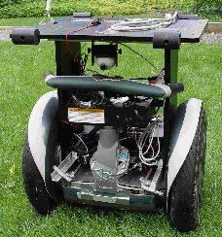
A-OPI: Empirical Implementation
Spatial positioning task with a Segway RMP robot
AAAI Spring Symposium : 23 March 2009 <number> Brenna D. Argall : The Robotics Institute

Slide 17
A-OPI: Improvement with Corrections
More Precise
Executions
Smaller Datasets
AAAI Spring Symposium : 23 March 2009 <number> Brenna D. Argall : The Robotics Institute

Slide 18
Conclusions
Development of multiple feedback types to address LfD error sources.
Binary critiques.
Corrective advice, via advice-operators.
Implementation of algorithms that incorporate each feedback type.
Algorithm Binary Critiquing (BC)
Algorithm Advice-Operator Policy Improvement (A-OPI)
Empirical validation shows performance improvement with feedback.
Simulated motion interception task (BC).
Segway RMP spatial positioning task (A-OPI).
Techniques appropriate for low-level motion control on a mobile robot.
AAAI Spring Symposium : 23 March 2009 <number> Brenna D. Argall : The Robotics Institute

Slide 19
Thank you!
Questions?
AAAI Spring Symposium : 23 March 2009 <number> Brenna D. Argall : The Robotics Institute

